Slide 1
Build 2: a script and
its measurement
Does my automation really save time and cut errors?
Applied AI and Automation | Session 8 of 12
KLAi Professional Learning | Jotham Martin Wambi
Notes:
Welcome to the second build session. Last time you set the limits for an automation. Today you run a real script on a real sheet, test it ten times and measure whether it saves time and cuts errors. The measurement is the point, because a number beats an opinion at the next board meeting.

Slide 2
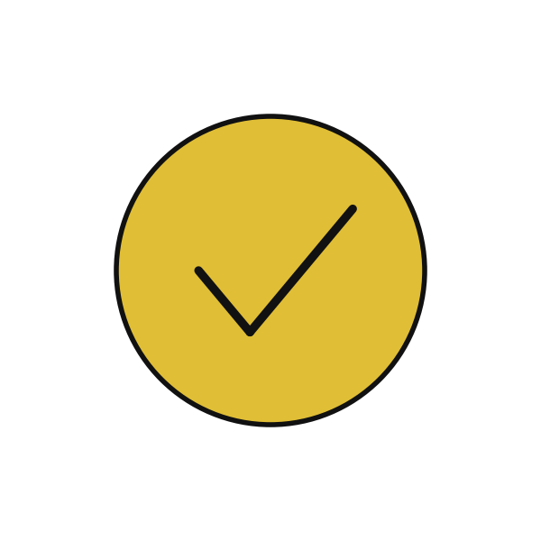
Today in one view: what you will leave with
By the end of today you will have
A working Apps Script automation pointed at your own sheet, with the secret key stored safely
A test log of ten tests, each with the result you expected and the result you got
One result line: how many minutes saved per run and how many errors found, against your Session 1 baseline
Notes:
Here is what you leave with. A working script pointed at your own sheet. A test log with ten tests. And one result line that says how many minutes you saved per run and how many errors were found, compared with the baseline you wrote in Session 1. Sixty minutes today are yours, so we move quickly through the ideas.

Slide 3
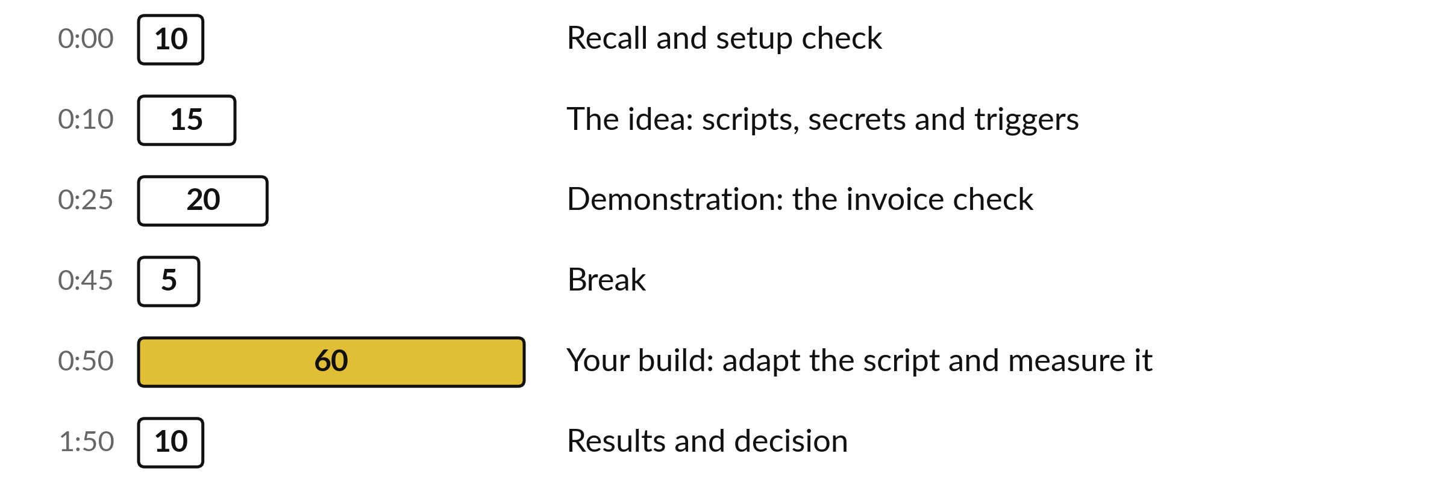
Your two hours: most of
the time is your own work
60 of the 120 minutes are yours: adapt the script, run ten tests and measure.
Notes:
Read the bars. Ten minutes recall, fifteen on the idea, twenty on a demonstration where I run the invoice check. Then a short break and sixty minutes for your own build. The last ten minutes are for your result and your decision. If we run late, I shorten my talking and protect your sixty minutes.

Slide 4
Three questions from last time
1. What goes on a tool boundary sheet?
2. Name one stop condition for an automation.
3. Why does an automation that reads incoming email need extra care?
Answer aloud first. Then we check together.
Notes:
Three questions from Session 7 about agents and controlled actions. Answer aloud before I show the answers. Think about the tool boundary sheet you filled in, because today you apply it to a real script.

Slide 5
Words we use today
Word | What it means
Script | A small program. Here it is a few files of code that live inside your Google Sheet.
Trigger | A rule that runs the script by itself at a set time, such as Monday at 7.
Script Properties | A private store inside the project where the secret key lives. The code reads it by name.
Dry run | A run that calculates and logs but changes nothing: no draft and no new sheet.
Run log | A sheet where every run adds one line: time, script, mode and a summary.
Notes:
Five words for today. A script is a small program inside your sheet. A trigger runs it at a set time. Script Properties is the private store for the secret key. A dry run calculates and logs but changes nothing. The run log records every run in one line. We use all five before the break.

Slide 6
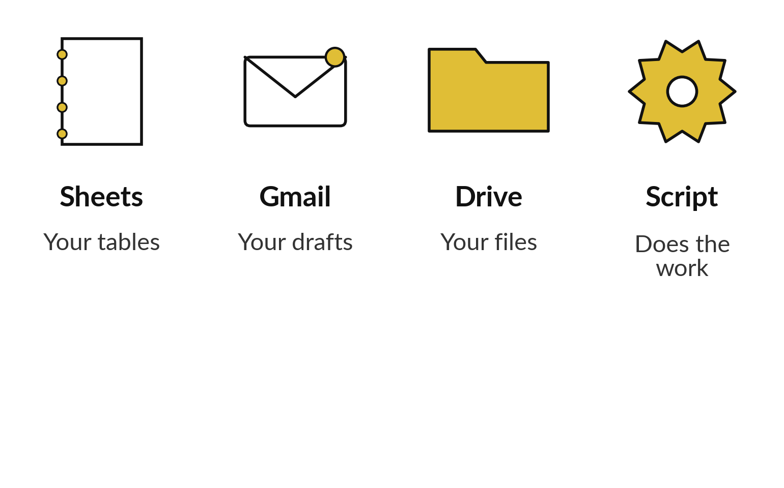
Apps Script is small programs
inside your own Google account
Small programs that live inside your Google Sheet, Gmail and Drive.
Free with a Google account.
It runs on Google’s servers, even when the sheet is closed.
We start with scripts that only read and draft.
Notes:
Google Apps Script sounds technical, so here it is in plain words. It is small programs that live inside your Google Sheet, Gmail and Drive. It is free with a Google account, and it runs on Google’s servers, so it can run on Monday morning while your laptop is shut. Today the scripts only read your sheet and save drafts. They never send an email and they never change your data. You do not need to write code. You will read it, change three lines and test it.

Slide 7
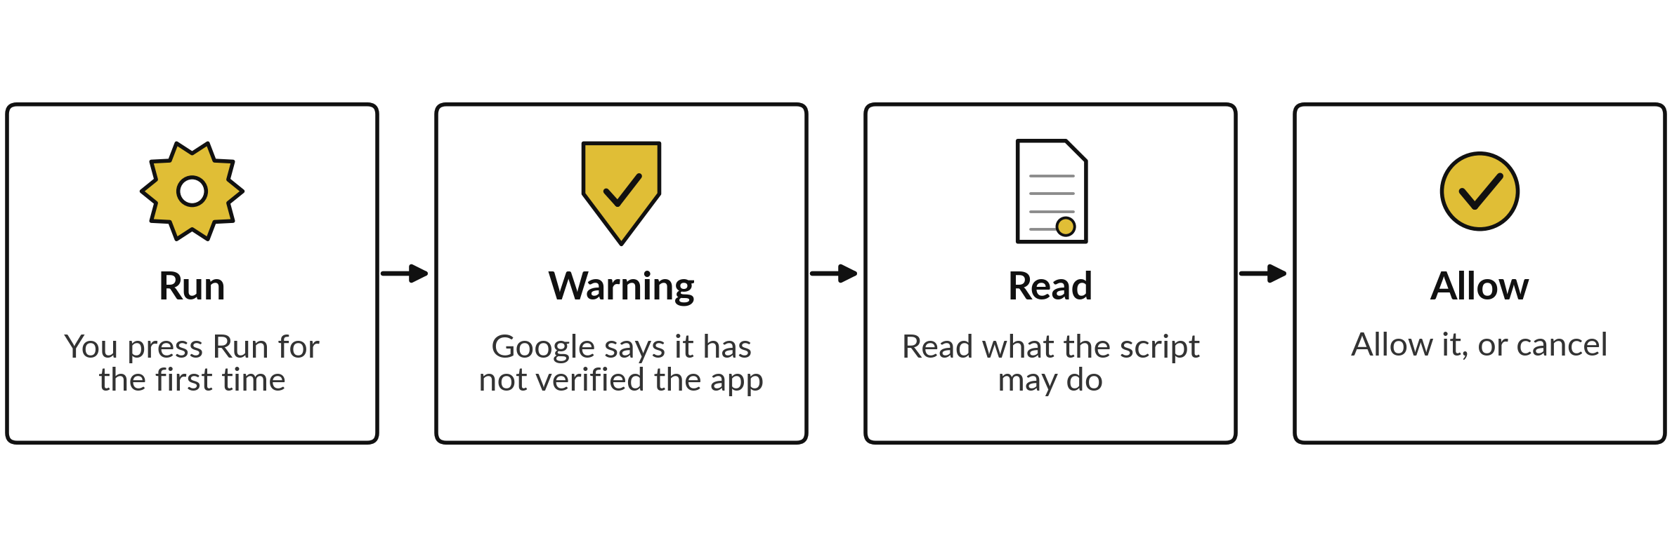
The first run asks your permission,
and you can take it back
Remove access later at myaccount.google.com/permissions. Wording on your screen may differ.
Notes:
The first time you run a script, Google asks for permission. You will see a warning that Google has not verified the app. That is normal for a script you pasted yourself, because you are the author. Read the list of what it may do before you allow it. The Gmail wording is broad even though our script only creates drafts, which is why we use a dedicated course account. You can remove the permission at any time at myaccount.google.com/permissions. Your screen may word these steps differently, so follow your screen.

Slide 8
Two supplied scripts do the work
and one helper keeps them safe
Script | What the code does | What it never does
weekly_digest | Adds up each region, works out the change on last week, saves a draft email. | Send an email.
invoice_check | Flags wrong totals, duplicates, missing PO numbers and zero VAT. | Change your invoice sheet.
ai_helper | One safe call to the AI, the run log and the off switch. | Add up or flag anything.
Notes:
Three files. The weekly digest reads your sales sheet, adds up each region, works out the change on the week before, and saves a draft email. It can never send. The invoice check reads a sheet of invoices and flags wrong totals, duplicate invoices, missing purchase order numbers and zero VAT. It only reads your sheet. The third file is a helper with one safe call to an AI model, the run log and the off switch. Notice that the arithmetic and the flagging are plain code. That is a deliberate choice.

Slide 9
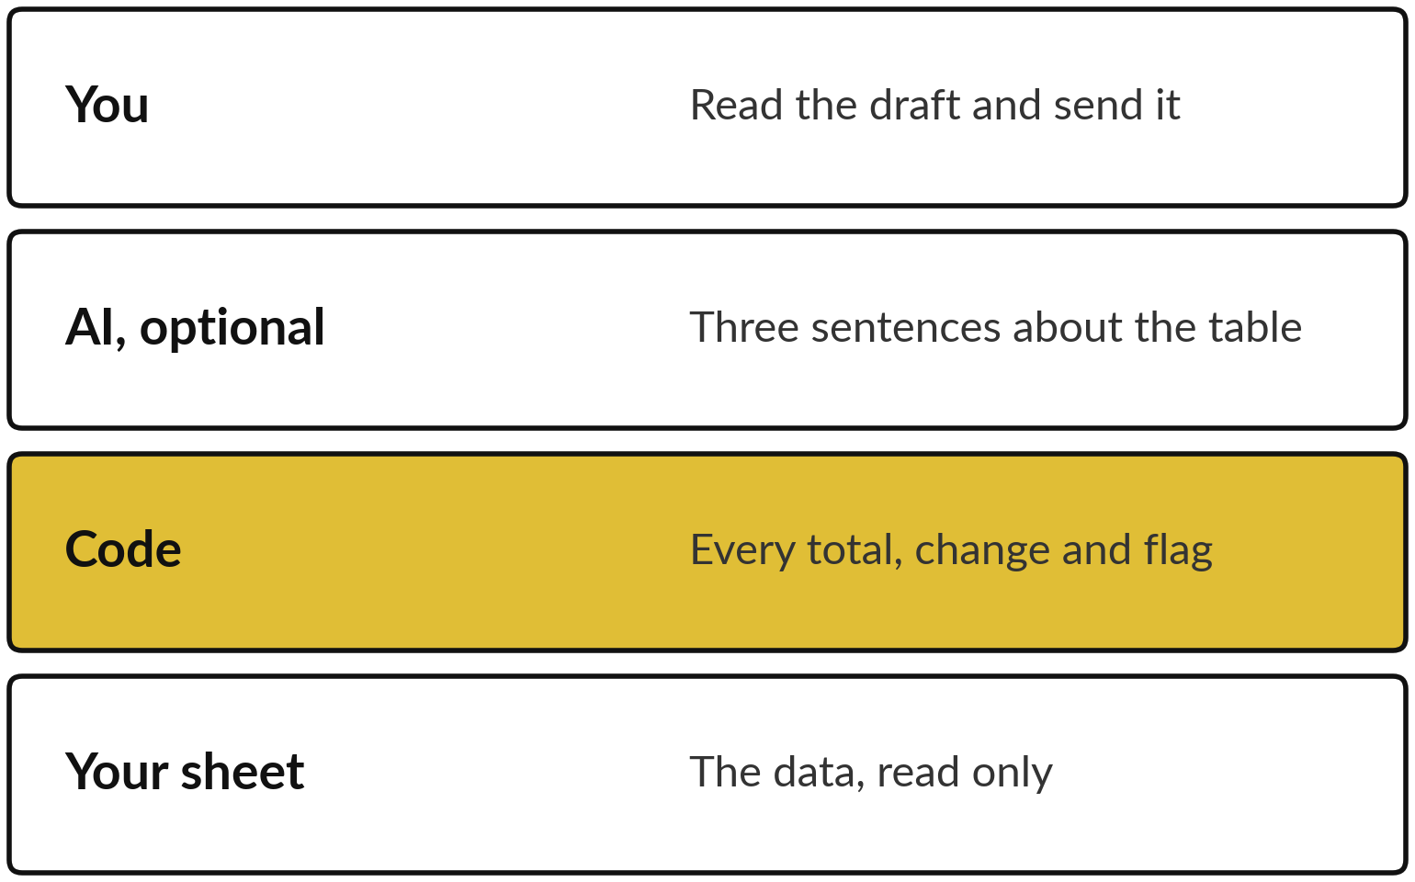
The code does the sums and
the AI may only describe them
Numbers come from code. Words may come from AI.
Code gives the same answer every run.
Check each AI sentence against the table.
Switch the AI off and the script still works.
Notes:
Remember the Session 1 rule: if a rule can do it, use a rule. Adding invoices is a rule, so plain code does it and gets the same answer every time. The AI has one optional job, which is to write three sentences about a table the code already built. Read each of those sentences against the table, because an AI can state a number that is not there. If you switch the AI off, the script still produces the full table. The person at the top, you, reads the draft and decides whether to send.

Slide 10

Keep the secret key in Script
Properties, never in the code
A key in the code is a password on the wall.
Script Properties is a private store in the project.
The code reads the key by name.
Never paste it in a chat, email or screenshot.
If it leaks, delete it and make a new one.
Notes:
If the AI step is on, the script needs a key from Google AI Studio. Think of a key in the code as a password written on the wall. Anyone who sees the code, a copy or a screenshot has the key. So you store it in Script Properties, a private store in the project settings, and the code asks for it by name. Never paste it in a chat or an email. If it leaks, delete it in AI Studio and make a new one. The free key also has a data rule that comes next.

Slide 11
Four limits to know before you press Run
Limit | Value to teach
Email recipients a day | 100 on consumer Gmail, 1,500 on Workspace
One run of a script | Stops at 6 minutes
Web calls a day, consumer account | 20,000
Free Gemini key | Fake or sample data only: free-tier content may be used to improve Google products
Quotas change. We re-check them in a real account on the day.
Notes:
Four limits. Email recipients a day: a hundred on a consumer Gmail account and fifteen hundred on Workspace. One run stops at six minutes, so a script for a huge sheet needs splitting. Web calls a day are generous on a consumer account. The last row matters most. On a free Gemini key, what you send may be used to improve Google products. So with a free key you use fake or sample data only. Real customer or staff data waits for a paid, approved set-up. These figures change, so I re-check them in a real account.

Slide 12
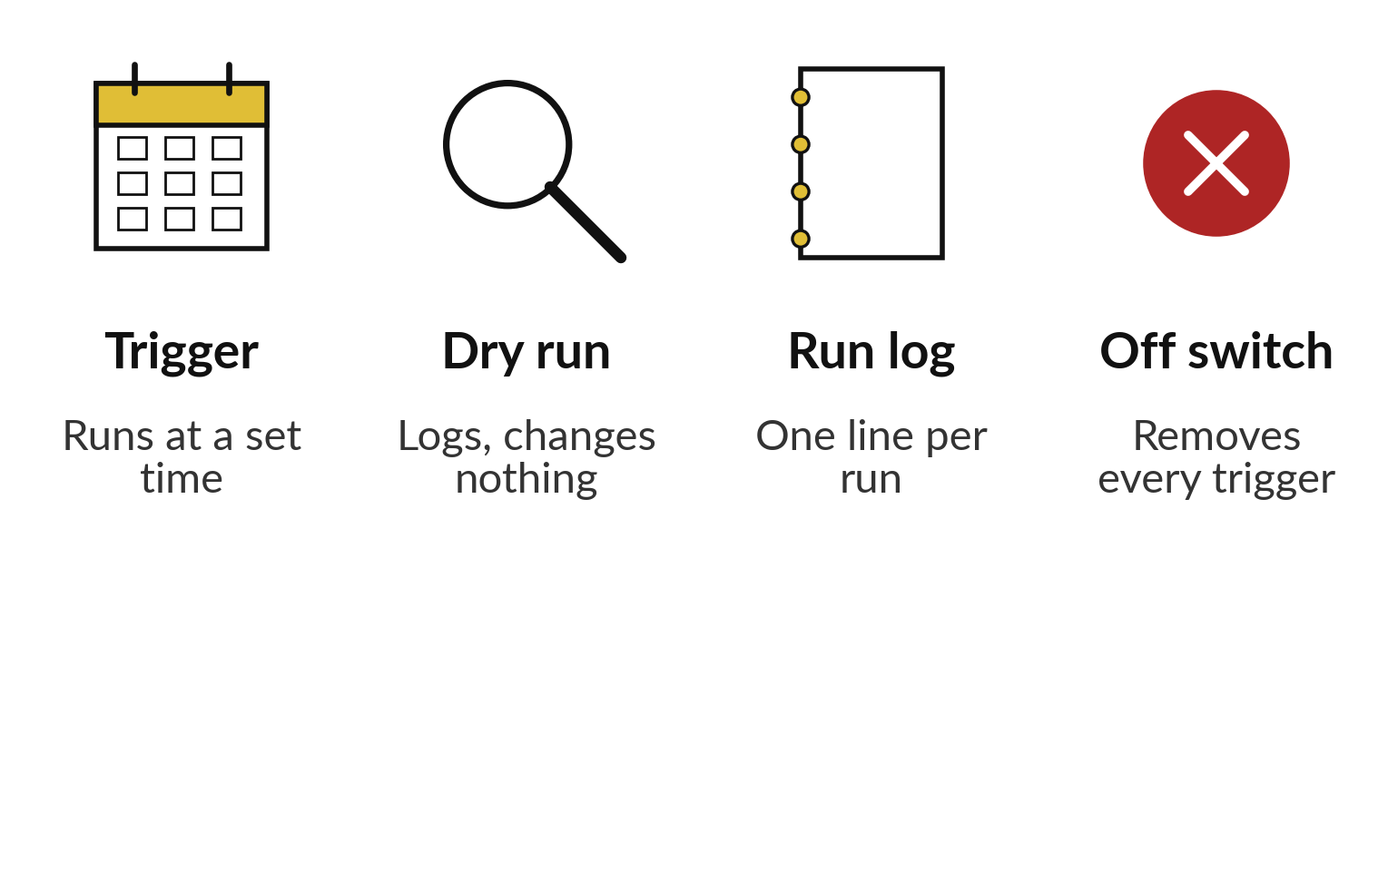
Triggers run alone, so start in
dry run and keep an off switch
Switch on only when the numbers match your own check.
Every script starts in dry run.
Name one owner.
Two people know the off switch.
Notes:
A trigger runs your script by itself, for example every Monday around seven. That is the saving, and also the risk, because a wrong script now runs without anyone watching. So every script starts in dry run: it calculates and logs and changes nothing. Every run adds one line to the run log. The off switch is a function that removes every trigger. Name one owner for the automation, and make sure a second person also knows where the off switch is. You switch the trigger on only when the numbers match your own check.

Slide 13
Demonstration: run invoice_check
on the supplier invoices
I will show
Watch for
Open the supplier_invoices sheet and run invoice_check in dry run.
Read the Run log line: invoices read and flags by type.
Check three flags with a calculator.
Which flags are errors and which need a person to decide.
What the detail column says about each flag.
The flags themselves. You will see them in class.
Notes:
Now I run the invoice check on the sixty supplier invoices of Nile Valley Foods. First in dry run, so nothing is written. I read the run log line, which tells us how many invoices were read and how many flags of each type. Then I take three flags and check them with a calculator, so you see that the code is testable. Watch which flags are real errors and which need a person to decide, such as a zero VAT line. You will see the flags in class, so count your own first.

Slide 14
The comparison to make: by hand,
with the script, one result line
Task: the Monday sales summary. Figures come from the Session 1 Task Card. The saved time stays blank until the tests are run.
By hand today
About 90 minutes, one person. Errors in about 4 emails out of 10. These are estimates.
With the script
Plan: draft in 10 minutes, checked in 20. You time the real figures in your ten tests.
Result line
“__ minutes saved per run, __ errors found.” Fill the blanks only from your test log.
Notes:
Here is the comparison for Nile Valley Foods, using the baseline from their Session 1 task card. By hand the Monday summary takes about ninety minutes, and about four emails in ten have an error. The plan is a draft in ten minutes and a check in twenty. That is only a plan, so the saving stays blank until the tests are run. The last row is your finished product: one line with minutes saved per run and errors found. Both blanks come from your test log.

Slide 15
Practice: change three lines
and run your script in dry run
20 minutes
Your own company task
Point a script at your own sheet, or at the Nile Valley Foods data.
You keep
A script whose total matches your own formula, and the Run log line that shows it.
Use a copy of your sheet without personal columns, or weekly_sales.
Change the three lines in weekly_digest, or the column names in invoice_check.
Run in dry run and read the Run log line.
Check the total against your own SUMIFS formula.
Notes:
Take twenty minutes. Work on a copy of your own sheet and delete any columns with personal data. If you prefer, use the Nile Valley Foods weekly sales sheet. Change the three lines at the top of the weekly digest: the tab name, the column to group by and the column to add up. Keep the script in dry run. Run it, read the run log line, then check the total with your own formula. If the two numbers differ, stop and call me. Do not trust a number you have not checked.

Slide 16
Practice: run ten tests and record each one
25 minutes
Your own company task
Fill ten rows of the Automation Test Log.
You keep
A test log with ten rows, a pass rate and the error types you found.
Type your target pass rate before you start.
Write the input, the expected and the actual result for each test.
Include two tests that break it on purpose, such as a wrong tab name.
Time the job by hand and with the script, including your checking.
Notes:
Twenty-five minutes for ten tests. First, type the pass rate you need before relying on the script, so you cannot move the goalposts afterwards. Then for each test write what you gave it, what you expected and what you got. Include two tests that break it on purpose, for example rename the tab or blank one cell, and see whether the script stops with a clear message. Time the job by hand and with the script, and include your own checking time in the second figure.

Slide 17
Practice: compare with your
baseline and write one line
15 minutes
Your own company task
Put the log summary next to your Session 1 Task Card.
You keep
One result line, backed by ten logged tests.
Read the pass rate and minutes saved on the Summary sheet.
Compare minutes by hand with your Task Card baseline.
Count the errors the script found that you missed by hand.
Write: X minutes saved per run, Y errors found.
Notes:
Fifteen minutes to measure. Open the Summary sheet and read the pass rate and the average minutes saved. Put it beside your task card from Session 1. Is the time by hand in your log close to your baseline, or was your estimate wrong? Then count the errors the script found that you had missed. I give you the number planted in the sample data after you have counted yours. Finish with one line: how many minutes saved per run, and how many errors found.

Slide 18
Decision: keep, change or stop this automation?
What does your test log say you should do?
Keep
Change
Stop
Pass rate meets your target and the saving is real. Name an owner and a review date.
Close, but some tests fail. Fix, retest and decide again.
The saving is small or the errors are risky. Say so and move on.
Write the decision, the owner and the review date on the test log.
Notes:
Time to decide, and your test log is the evidence. Keep it if the pass rate meets the target you wrote before testing and the saving is real; then name the owner and a review date. Change it if you are close but some tests fail; fix them, retest and decide again. Stop if the saving is small or the errors are risky. Stopping is a good result, because you learned it for the price of one afternoon. Write the decision, the owner and the review date.

Slide 19

Save it, and bring one question to the next session
What you keep from today
Your working script, your measured test log and one result line: “X minutes saved per run, Y errors found.”
Next session
Session 9: Risk, security and the law. You will list what could go wrong with your task and draft your company AI-use policy.
Notes:
Save the script, the test log and your result line. Write the owner of the automation on the log, and write who can switch it off. Before next session, ask yourself one question: if this automation made a mistake tomorrow, who would be hurt first? That question starts the risk register.

